Slide 1
https://www.youtube.com/watch?v=HEheh1BH34Q
https://www.youtube.com/watch?v=1Eh5BpSnBBw
https://www.youtube.com/watch?v=Qa7v7jqf6xg

Slide 2

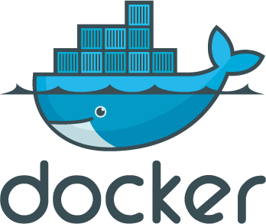

Docker and Azure
Steve Lasker
Program Manager
Microsoft Azure Developer Experiences
Level: Intermediate
Notes:
Docker has become one of the hottest topics for developer teams targeting either on-premises or in the cloud. In this session, You'll hear an overview of Container Technologies, why .NET developers should care about Docker, how you can prepare your apps, and how to architect your apps to work with Containers. You'll be introduced to additional topics like Docker Compose and Docker Swarm work and show how to build, test, diagnose, and deploy .NET apps to both Linux and Windows Server containers.

Slide 3



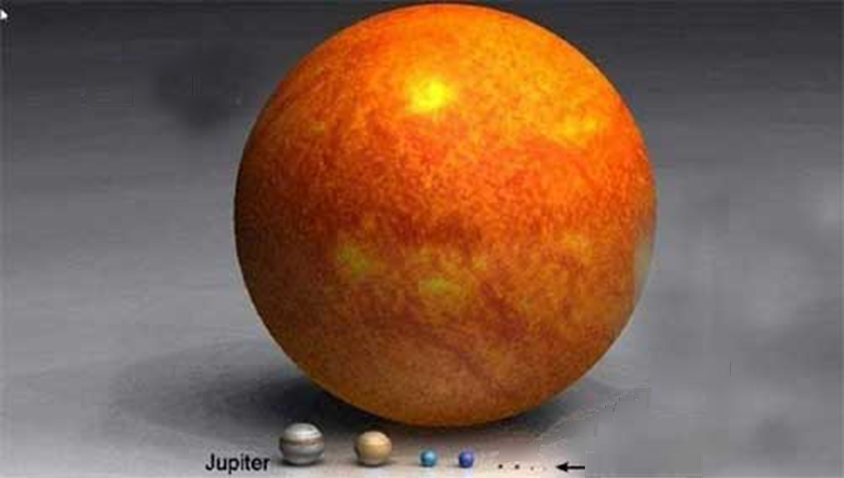

Our Sun
Pluto

Slide 4
Foot
Beating
Forestay
Nun
In Irons
Packing Gland
Seacock
Skeg
Singlehanded
Spreader
Whip
Whisker Pole
Close Hauled
Roach
Puff
Sheave
Luft
Cunningham
Hard-A-Lee
Vang
Can
Sole
Vee-berth
Clew
Tack
Jacklines
Toppinglift
Beam Reach
Jive
Lazy Sheet
Bear Away
Broad Rach
Weather Helm
Port
Starboard
Give Way Vessel
Stand On Vessel

Slide 5
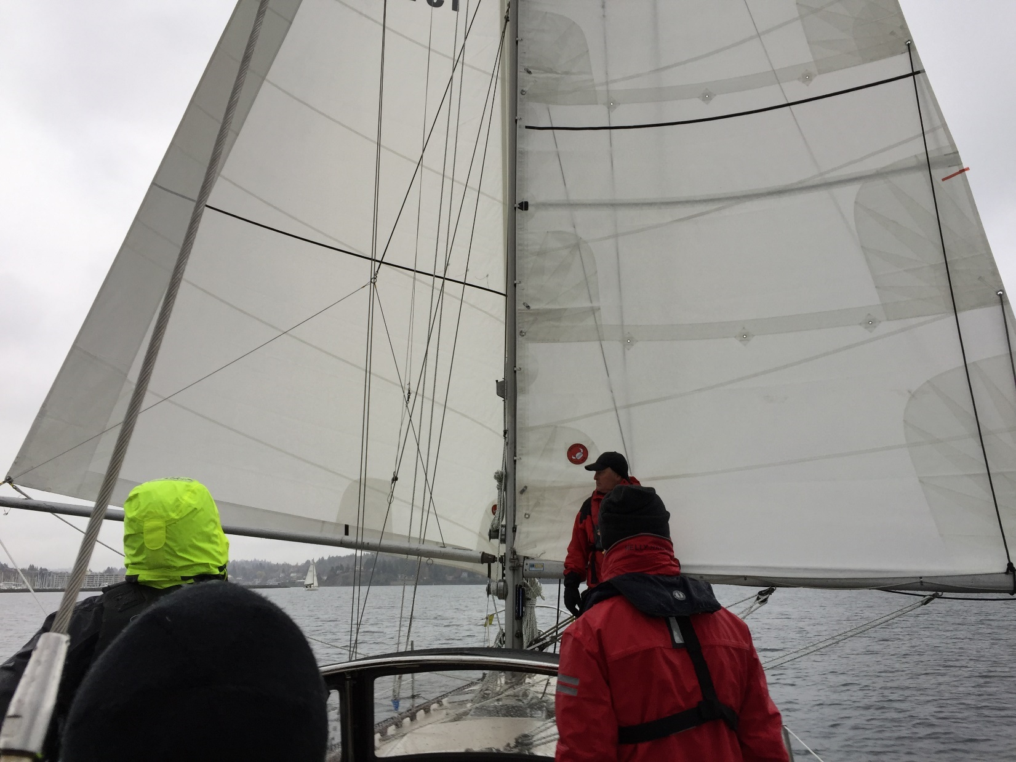


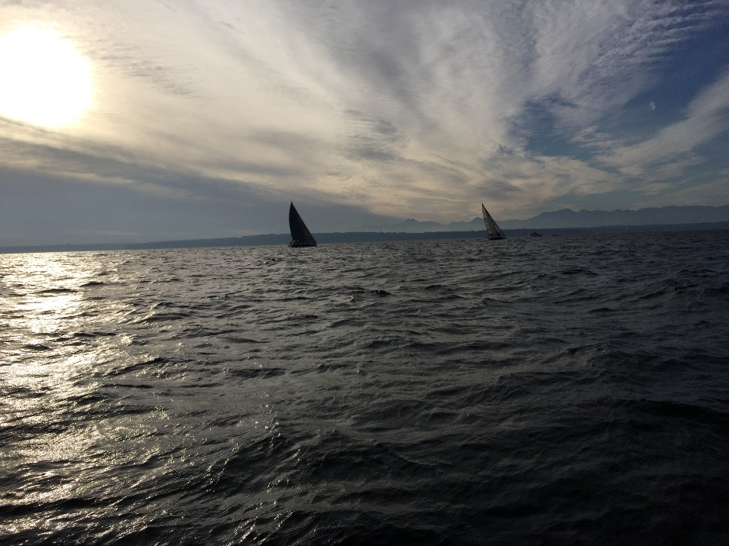

Slide 6
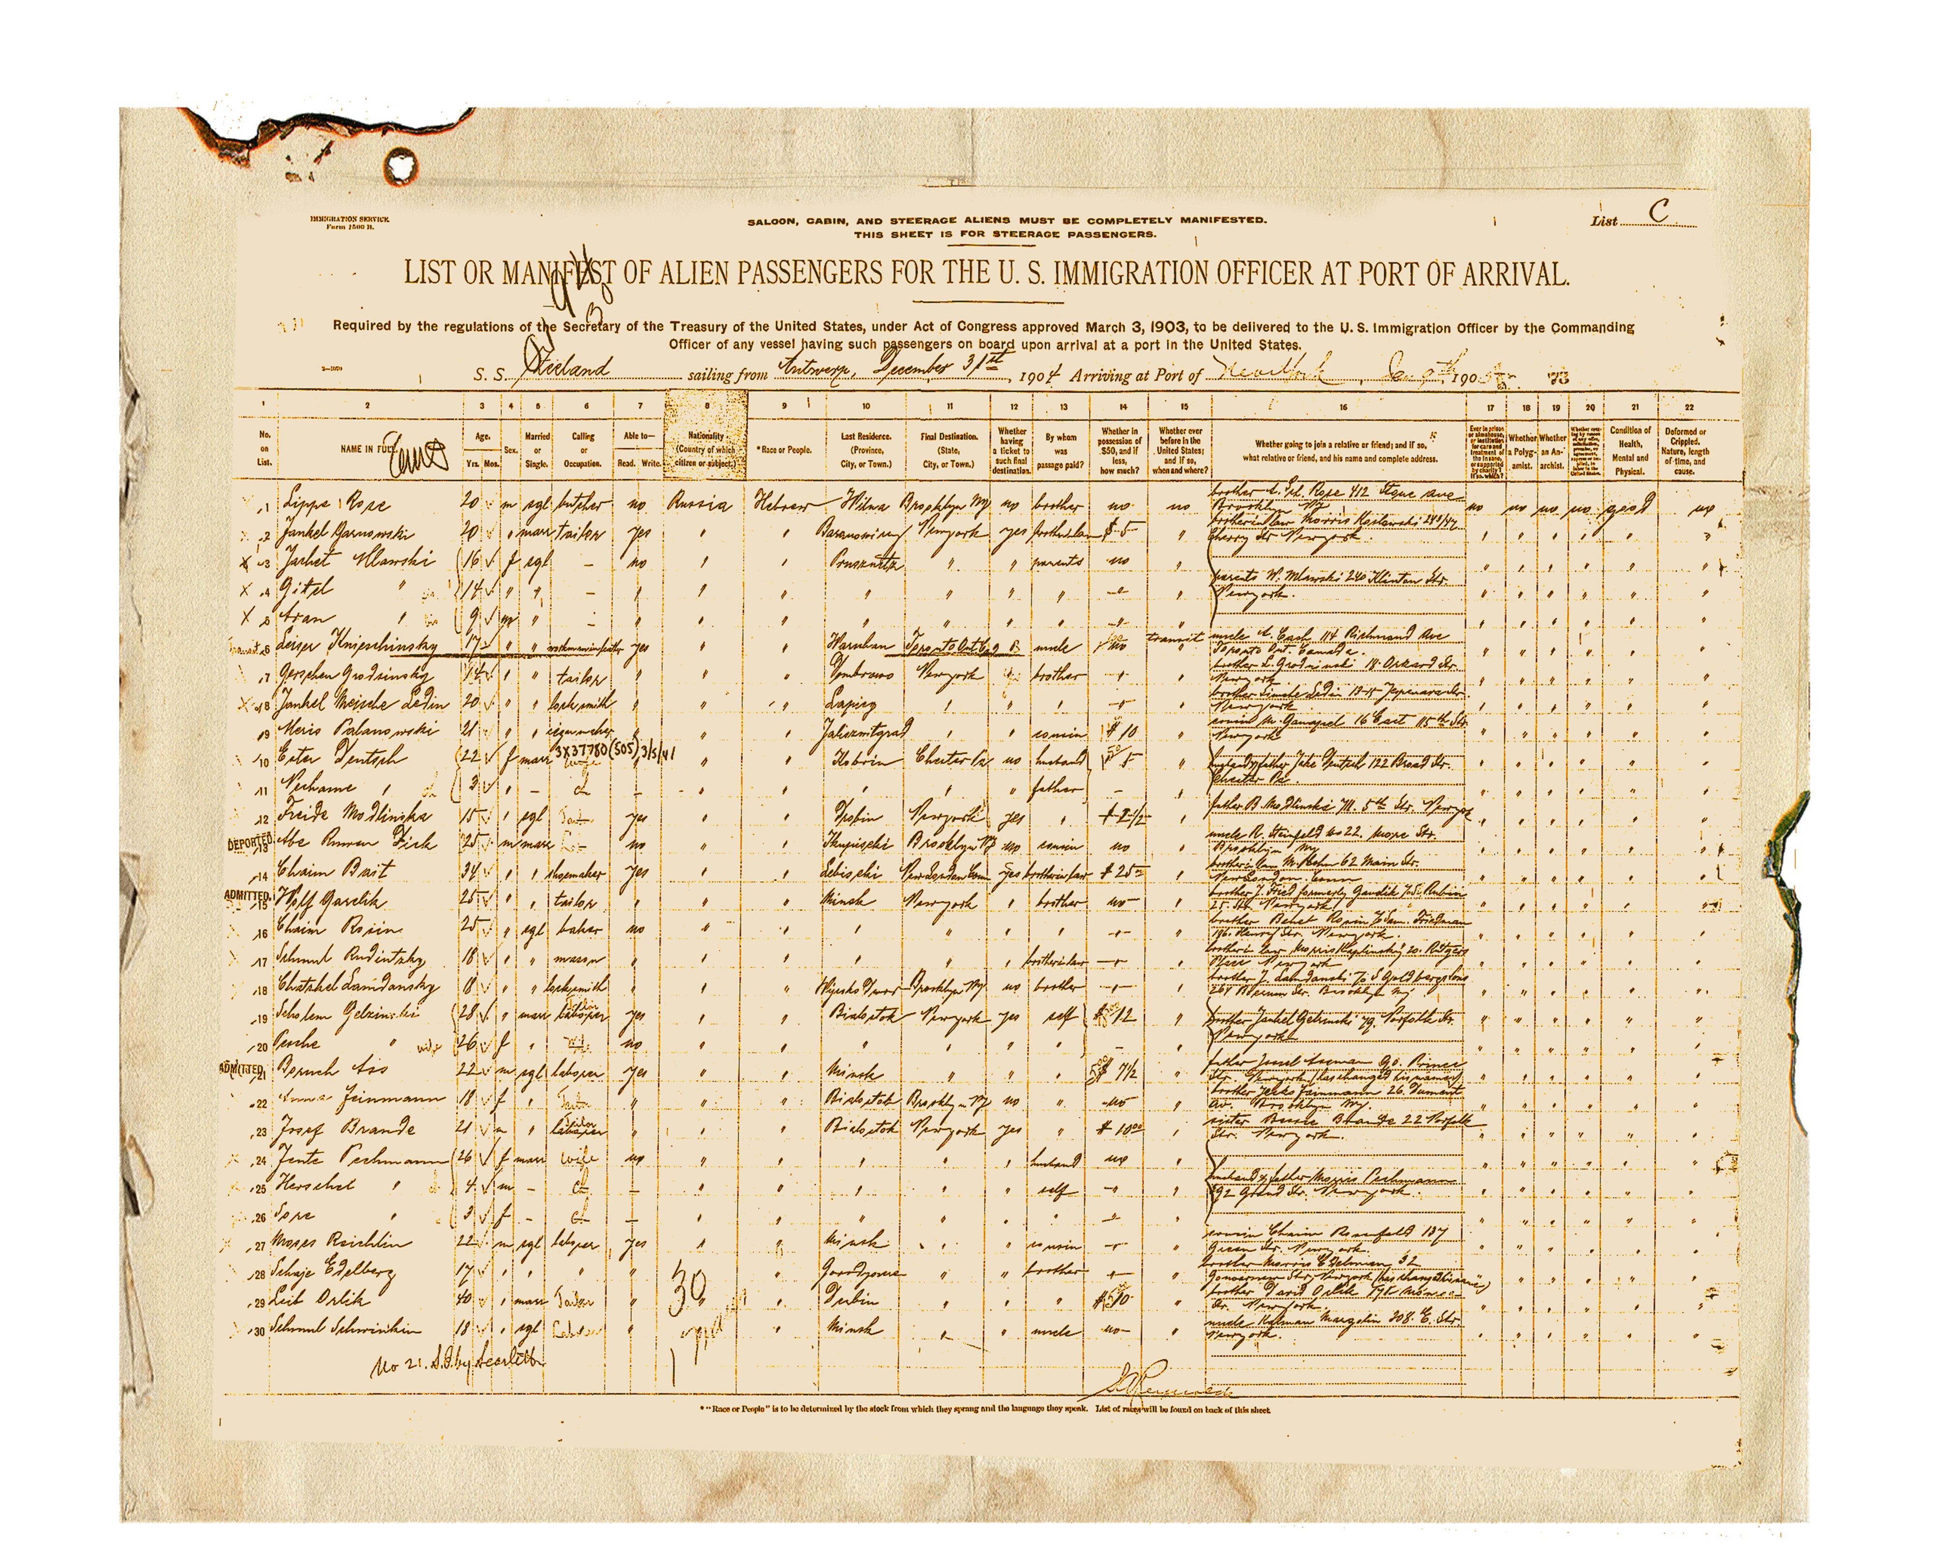
Shipping Manifest
Big Picture for working with Containers
Container Vocabulary
Container Architecture
Micro Services and Containerization
ASP.NET Core
Visual Studio
Visual Studio Team Services
Azure Container Service

Slide 7

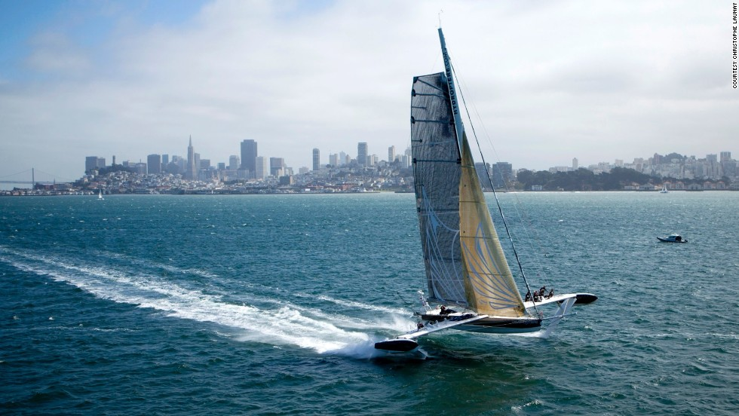
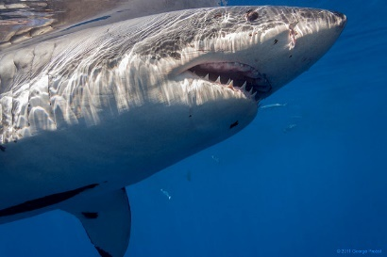
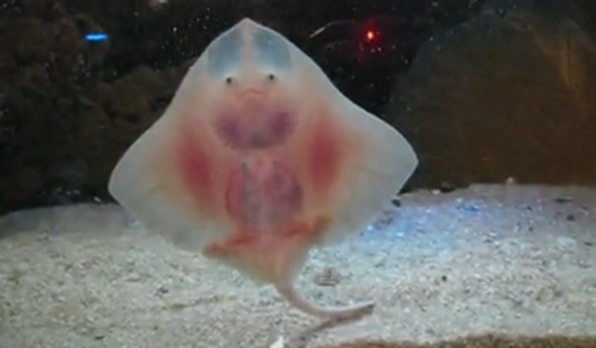
Notes:
We’re going to cover many topics, provide an overview of the end to end experience
There will be interesting things along the way, not all of which we’ll have time to dig into

Slide 8
Container Lingua Franca
Vocabulary
Agent
Client
Compose
Container
Dockerfile
Host
Image
Master
Orchestrator
Registry
Scaffold
Scheduler
Slave
Tag
Volume
Layers
Labels
Registry
Swarm
Container Services
Tags
Service
Ports
Commands
Docker-Machine Create, Env, Ip, Start, Restart, Active
Docker build, login, pull, push, run, search, tag
Docker-Compose Up, Build, Scale

Slide 9


Start on Earth – Docker Hello-World
Docker Containers and VMs
Host OS - Hardware
Hyper Visor
Guest OS #1 (Virtual Machine)
Guest OS #2
Docker Daemon

Slide 10
App A
App A’
App B
Containers are isolated, but share OS and, where appropriate, bins/libraries
Bins/Libs
Bins/Libs
Bins/Libs
Guest OS
Guest OS
Guest OS
App A
App A’
App B
App B’
App B
App B’
App B
App B’
Bins/Libs
Bins/Libs
Hypervisor
Docker Engine
Host OS
Host OS
Server
Server

Slide 11
Demo
PS docker run -it busybox
Unable to find image 'busybox:latest' locally
latest: Pulling from library/busybox
f810322bba2c: Already exists
a3ed95caeb02: Already exists
Digest: sha256:97473e34e311e6c1b3f61f2a721d038d1e5eef17d98d1353a513007cf46ca6bd
Status: Downloaded newer image for busybox:latest
/ # ls
bin dev etc home proc root sys tmp usr var
/ # ps
PID USER TIME COMMAND
1 root 0:00 sh
8 root 0:00 ps
/ # cd usr
/usr # touch a
/usr # touch b
/usr # touch c
/usr # ls
a b c sbin
/usr

Slide 12
Cool, but where did busybox come from?

Slide 13
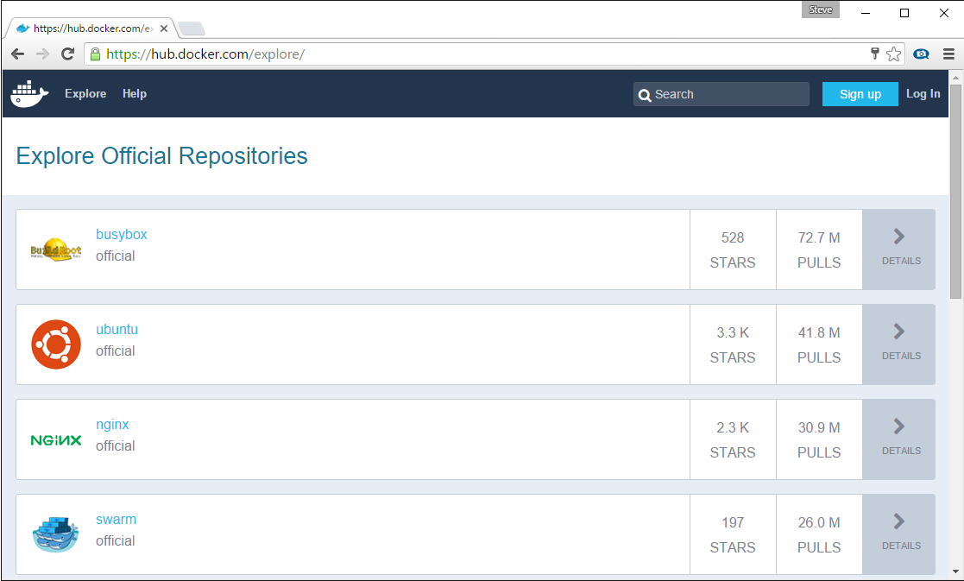
Docker Registry
Stores docker images
Searchable
Public Registry – Hub.Docker.com
Private Registries – Instanced for you
Can be hosted in Docker, Azure, AWS, Google, …

Slide 14
Demo
PS docker search microsoft
NAME DESCRIPTION STARS OFFICIAL AUTOMATED
microsoft/aspnet ASP.NET is an open source server-side Web ... 372 [OK]
mono Mono is an open source implementation of M... 119 [OK]
microsoft/azure-cli Docker image for Microsoft Azure Command L... 36 [OK]
suchja/wix Creates installer packages (MSI) for Micro... 2 [OK]
microsoft/applicationinsights Application Insights for Docker helps you ... 2 [OK]
sequenceiq/azure-cli-tools Command line tool to deploy the MicrosoftD... 1 [OK]
microsoft/oms Monitor your containers using the Operatio... 1 [OK]
PS docker pull microsoft/aspnet
Using default tag: latest
latest: Pulling from microsoft/aspnet
604d05dfd165: Extracting [====================================================> ] 34.78 MB/37.19 MB
a3ed95caeb02: Download complete
af271166b5e5: Download complete
ffff72610562: Pull complete
82633c2ea8fc: Pull complete
1ec63dc1715b: Downloading [=========================> ] 29.72 MB/64.67 MB
9be54d5ae146: Pull complete
c3abf6246d6a: Pull complete
Digest: sha256:cbbc0a7be0926d017ffd952799c4864c2c6cf812cbb70862bf2c8539401aa1e3
Status: Downloaded newer image for microsoft/aspnet:latest

Slide 15











Docker API
Client
DOCKER_HOST
Registry
Docker pull
Docker daemon
Docker run
Containers
Images Cache

Slide 16
Vocabulary
Host A VM running the Docker Daemon to host a collection of Docker Containers
Client Where docker commands are executed ^{(client/server)}
Image An ordered collection of filesystems* to be used when instancing a container ^{– * see layers, later on}
Container A runtime instance of an image
Registry A collection of docker images
Commands
Docker run The process of instancing an Image as a running container
Docker search Searches the current registry
Docker pull Pulls a Docker Image to your Docker Host cache
Understanding the Docker Architecture

Slide 17
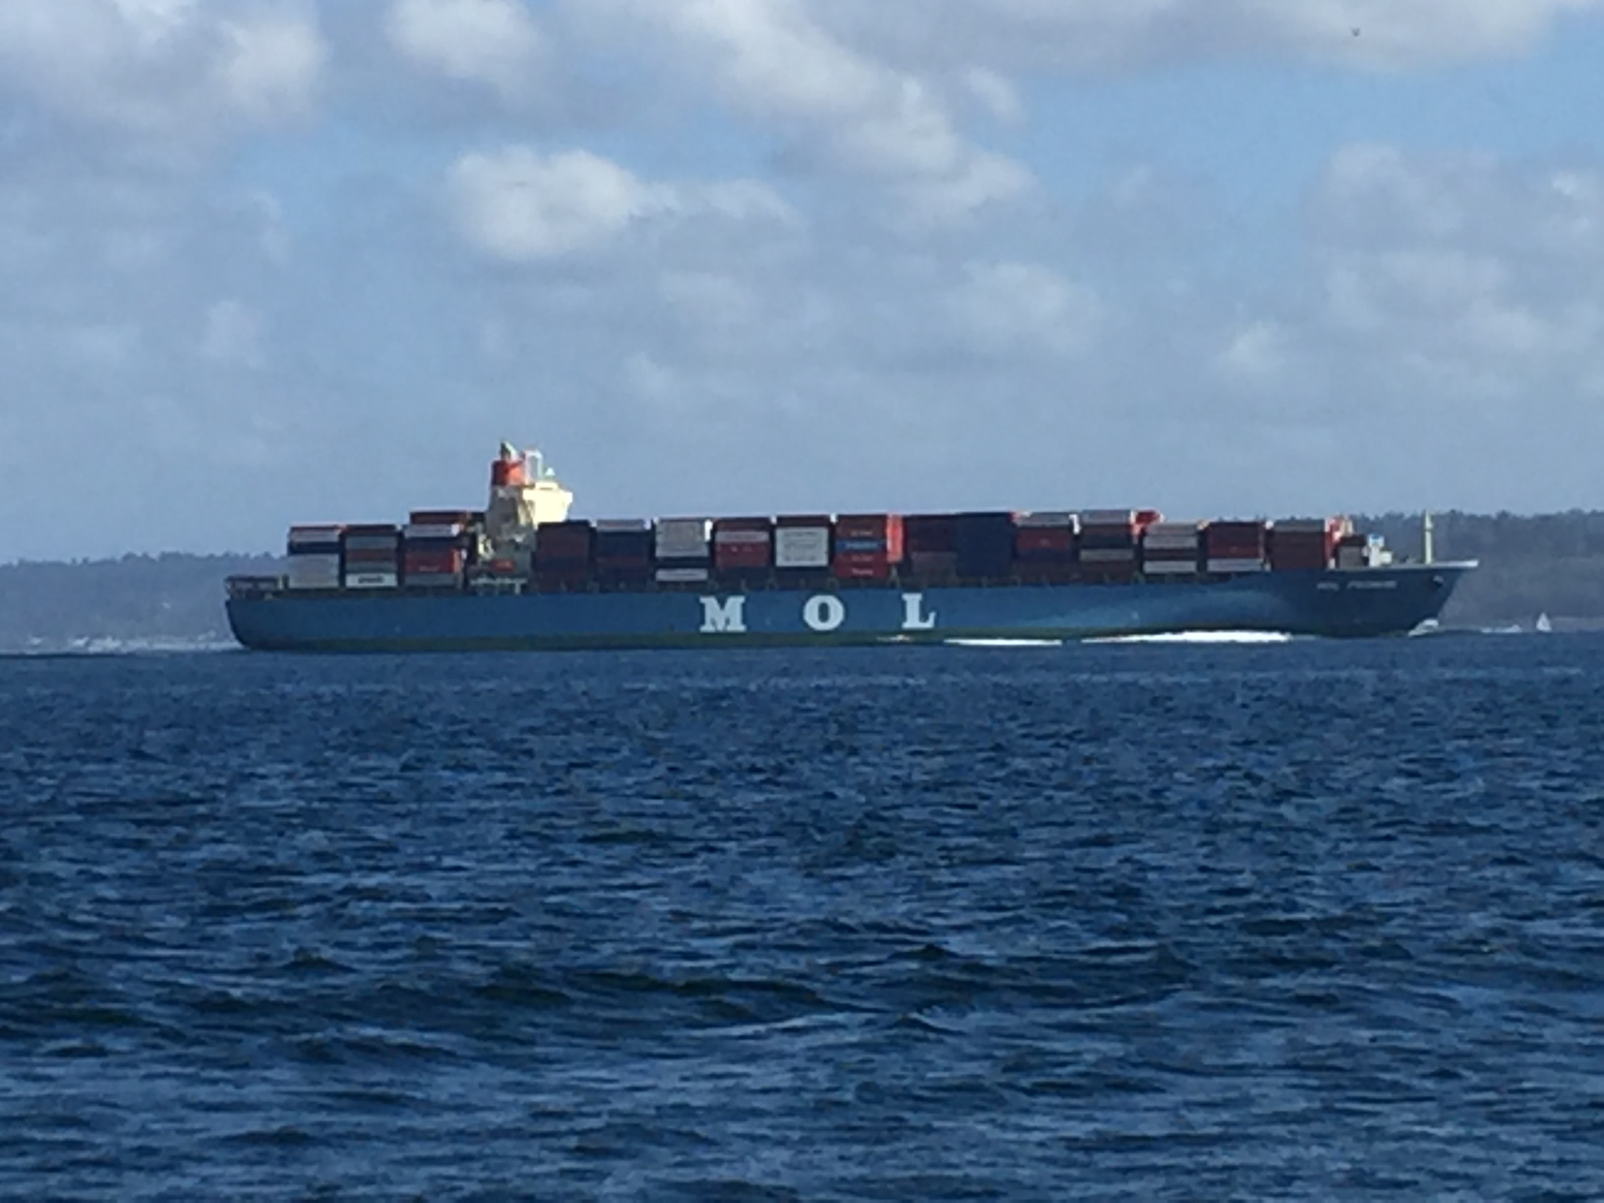
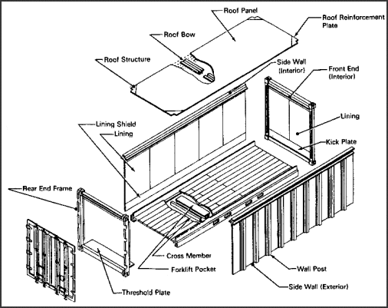
Building Docker Images

Slide 18
Demo - build
PS Code .
PS Docker build –t node-hello-world .
Sending build context to Docker daemon 3.072 kB
Step 1 : FROM node:0.12
---> 0d09d339d757
Step 2 : COPY server.js /server.js
---> 900cefa8acd3
Removing intermediate container 34e26d7b0734
Step 3 : CMD node server.js
---> Running in 91b08051fd43
---> 06436eb3523e
Removing intermediate container 91b08051fd43
Successfully built 06436eb3523e
PS docker images
REPOSITORY TAG IMAGE ID CREATED SIZE
node-hello-world latest 06436eb3523e 5 seconds ago 637.1 MB
PS docker run –d -p 80:8080 node-hello-world
PS docker ps
CONTAINER ID IMAGE COMMAND STATUS PORTS NAMES
2b2430e1cd36 node-hello-world "/bin/sh -c 'node ser" Up 25 seconds 0.0.0.0:80->80/tcp cranky_austin

Slide 19

Docker build
Registry
DOCKER_HOST
Private Registry
Docker daemon
Containers
Images
dockerfile
FROM node:0.12
COPY server.js /server.js
CMD node server.js
Code/Binaries
000101011101110110
server.js
111010111011011010
Client
Docker build
Docker run
Docker push

Slide 20
Demo - push
PS docker login
Username (stevelasker):
Password:
WARNING: login credentials saved in C:\Users\SteveLas\.docker\config.json
Login Succeeded
PS docker tag node-hello-world stevelasker/node-hello-world:v1
The push refers to a repository [docker.io/stevelasker/node-hello-world]
5f70bf18a086: Pushed
b97375f965df: Layer already exists
ba7a5ba43daa: Pushed
ca3a6ab52687: Pushed
162da15b5454: Pushing [==========================================> ] 103.5 MB/122.6 MB
162da15b5454: Pushing [================================> ] 9.201 MB/44.41 MB
4badccf8a533: Retrying in 8 seconds
ddef881aeaff: Waiting
v1: digest: sha256:71acc144df8563d7f319e5c65108490501a8a67364db5517db792d721d92dfc0 size: 8203

Slide 21

Vocabulary
Host A VM running the Docker Daemon to host a collection of Docker Containers
Image An ordered collection of filesystems* to be used when instancing a container
Container A runtime instance of an image
Registry A collection of docker images
Dockerfile Commands to build a Docker image
Tag A version identifier for an image, plus the registry name docker tag [registrypath]/image:[version]
Commands
Docker search Searches the current registry
Docker pull Pulls a Docker Image to your Docker Host cache
Docker run The process of instancing an Image as a running container
Docker login Logs into the registry so you can push images
Docker build Creates an image, using a dockerfile as the definition
Docker tag Renames an image: [registryname]/[user]/[imagename]:[tag]
Docker push Pushes an image to a registry
Understanding the Docker Architecture

Slide 22

Where are we?
Pulled and instanced images
Built our own image
Ran it multiple times ^{on different ports}
Tagged it for the docker registry
Pushed it to a docker registry
A few parking lot issues to cover…

Slide 23
Networking
Host OS
Docker Networking uses NAT to route inbound traffic to each container
Each container can use the same port, internal to it’s container, but must be addressable outside by unique ports per HOST
Load Balancers and Service Discovery are new important topics
Note: networking may vary based on your orchestration engine
eth0: 10.100.2.100
DOCKER_HOST
Docker daemon
docker0: 192.168.1.100
:80
:8001
:8002
:8003
Container1
Container2
eth0: 172.17.0.2
eth0: 172.17.0.3
veth473629a
veth5998974
Container3
Container4
eth0: 172.17.0.4
eth0: 172.17.0.5
veth736321c
veth2726149b

Slide 24
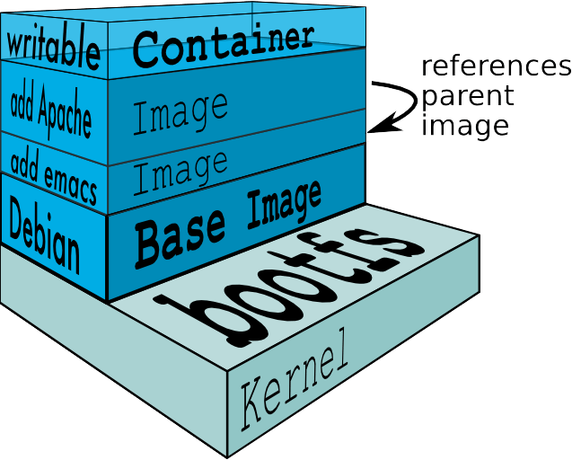
Docker Layers
ImageLayers.io

Slide 25
Persistent Storage
Docker Containers are Immutable
To save data, you must provide external storage
Scenarios:
Logs
Database Files
Inner Loop Development – mounting your source
Volume Drivers

Slide 26
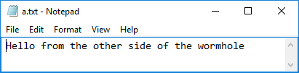
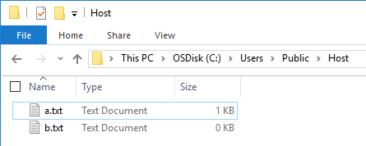

Docker Volume
Docker run -v hostpath:/containerpath
PS docker run -it -v /c/Users/Public/Host:/wormhole busybox
/ # ls
bin dev etc home proc root sys tmp usr var wormhole
/ # cd wormhole
/wormhole # touch a.txt
/wormhole # touch b.txt
/wormhole # ls
a.txt b.txt
/wormhole # cat a.txt
Hello from the other side of the wormhole
/wormhole #

Slide 27
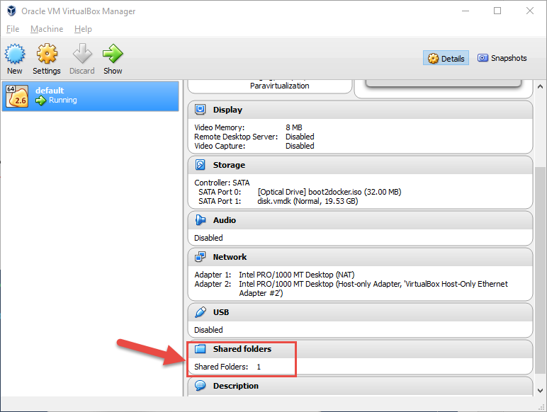
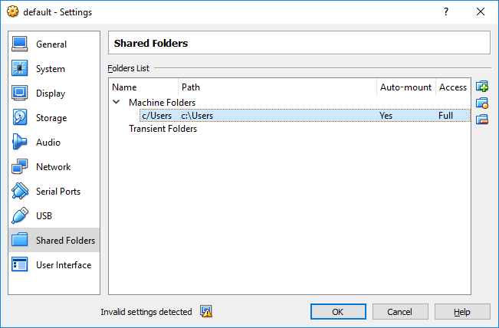
Docker Volume
Using VirtualBox ^{(local)}, be sure to sit below c/Users, and confirm case sensitivity. ^{(Linux)}

Slide 28
Vocabulary
Host A VM running the Docker Daemon to host a collection of Docker Containers
Image An ordered collection of filesystems* to be used when instancing a container – * see layers, later on
Container A runtime instance of an image
Registry A collection of docker images
Dockerfile Commands to build a Docker image
Tag A version identifier for an image
Volume A means to provide persistent storage from an immutable container
Commands
Docker run The process of instancing an Image as a running container
Docker login Logs into the registry so you can push images
Docker build Creates an image, using a dockerfile as the definition
Docker tag Renames an image: [registryname]/[user]/[imagename]:[tag]
Docker push Pushes an image to a registry
Docker run –v h:c Create a wormhole from the host to the container, represented as a volume Refer to docker-compose for common usage scenarios
Docker-compose Volumes

Slide 29
Working with multiple hosts
You have a local Docker HOST local development
Several hosts in Azure Dev/Test labs as part of your isolated development environment
Need to troubleshoot issues in your cluster
How do you maintain and manage the certs for each?

Slide 30

Docker-Machine.exe
Manages your various host configurations
Stored in %USERPROFILE%\.docker\machine\
PS docker-machine ls
NAME ACTIVE DRIVER STATE URL DOCKER
default - virtualbox Running tcp://docker v1/10.1
dockerhost-linux - azure Running tcp://dockerhost-linux.cloudapp.net:2376 v1.10.2
PS docker-machine env dockerhost-linux
$Env:DOCKER_TLS_VERIFY = "1"
$Env:DOCKER_HOST = "tcp://dockerhost-linux.cloudapp.net:2376"
$Env:DOCKER_CERT_PATH = "C:\Users\SteveLas\.docker\machine\machines\dockerhost-linux"
$Env:DOCKER_MACHINE_NAME = "dockerhost-linux"
# Run this command to configure your shell:
# & "docker-machine.exe" env dockerhost-linux | Invoke-Expression
PS docker-machine active
dockerhost-linux
PS docker-machine ip dockerhost-linux
dockerhost-linux.cloudapp.net

Slide 31
Docker-Machine - Create
Provisions Docker Hosts In Azure
Linux for now, Windows Coming
PS openssl req -x509 -nodes -days 365 -newkey rsa:1024 -keyout AzureMgmnt.pem -out AzureMgmnt.pem
PS openssl pkcs12 -export -out AzureMgmnt.pfx -in AzureMgmnt.pem -name "Azure Management Cert"
PS openssl x509 -inform pem -in AzureMgmnt.pem -outform der -out AzureMgmnt.cer
PS docker-machine create -d azure --azure-subscription-id=“[your azure sub id]" --azure-subscription-cert="C:\Users\SteveLas\.docker\AzureCerts\AzureMgmnt.pem" dockerhost-linux
Docker Docs - Docker-machine create -d azure...
Azure Docs - Docker-machine create -d azure ...

Slide 32
Commands
Docker-machine create Provisions a VM with the Docker daemon installed and configured locally for use
Docker-machine env Switches between host entries
Docker-machine ls Lists the currently configured hosts
Docker-machine active The currently configured host
Docker-machine start Starts the named host – required on reboot for VirtualBox
Docker-machine ip Provides the URI for the named host
Docker Docs - Docker-machine create -d azure...
Azure Docs - Docker-machine create -d azure ...

Slide 33
Instancing Multiple Services
How do you instance several different services at the same time?
Are you building Micro Services?
How to manage configurations between environments?

Slide 34

Docker-Compose.exe
API above docker run
Used to instance multiple containers 1:~
Can reference dockerfiles and/or images
Paired with docker-compose.yml

Slide 35
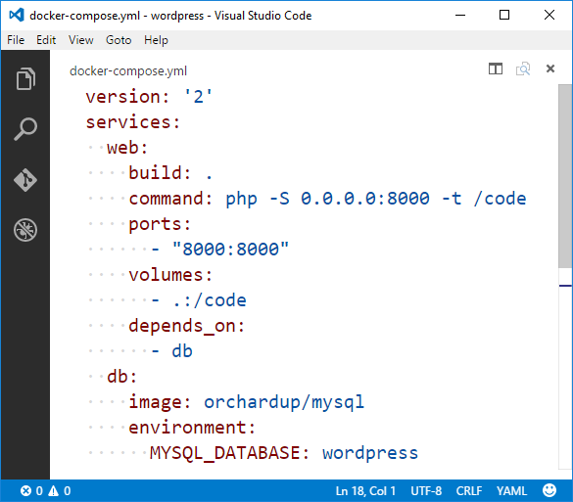
Demo: Compose
PS docker-compose up -d
Pulling db (orchardup/mysql:latest)...
latest: Pulling from orchardup/mysql
...
Status: Downloaded newer image for orchardup/mysql:latest
Creating wordpress_db_1
Building web
Step 1 : FROM orchardup/php5
latest: Pulling from orchardup/php5
...
Digest: sha256:166c2488a7cd60dc02f0cfcb0b606db38ff251f36cb5b10e8b837d9619c41036
Status: Downloaded newer image for orchardup/php5:latest
---> d8e939bb8720
Step 2 : ADD . /code
---> 74ef767963f1
Successfully built 74ef767963f1
Creating wordpress_web_1
https://docs.docker.com/compose/wordpress/

Slide 36





Docker compose
Docker-compose.yml
Registry
services:
web:
build: .
ports:
- "8000:8000"
volumes:
- .:/code
depends_on:
- db
db:
image: orchardup/mysql
environment:
MYSQL_DATABASE: wordpress
DOCKER_HOST
Private Registry
Docker daemon
Containers
Images
Code/Binaries
Wordpress …
Client
dockerfile
Docker-compose
FROM orchardup/php5
ADD . /code

Slide 37
Vocabulary
Host A VM running the Docker Daemon to host a collection of Docker Containers
Image An ordered collection of filesystems* to be used when instancing a container – * see layers, later on
Container A runtime instance of an image
Registry A collection of docker images
Compose define multi-container applications with all dependencies in a single file, then spin up in a single command
Commands
Docker login Logs into the registry so you can push images
Docker build Creates an image, using a dockerfile as the definition
Docker tag Renames an image: [registryname]/[user]/[imagename]:[tag]
Docker push Pushes an image to a registry
Docker-compose up Use a docker-compose.yml file to build and/or run a collection of containers
docker compose

Slide 38
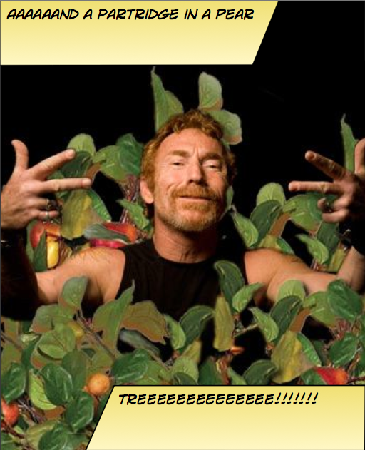
Instancing Multiple Copies
You need:
10 web front ends
8 API instances
4 Redis Cache
1 Database

Slide 39

Web
Web
Web
Web
Web
API
API
API
Cache
Cache

Slide 40
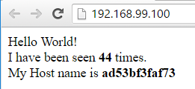
Demo: Scale
PS docker-compose up –d
Creating scale_redis_1
Building web
Creating scale_web_1
Creating scale_lb_1
PS start-process http://192.168.99.100
PS docker-compose scale web=3
Creating and starting 2 ... done
Creating and starting 3 ... done
PS docker-compose up --force-recreate –d
Recreating scale_redis_1
Recreating scale_web_3
Recreating scale_web_2
Recreating scale_web_1
Recreating scale_lb_1
PS start-process http://192.168.99.100
PS docker run -d -p 9000:9000 --privileged -v /var/run/docker.sock:/var/run/docker.sock dockerui/dockerui
https://docs.docker.com/compose/wordpress/

Slide 41
Load Balancing & Fault Tolerance
DOCKER_HOST
Docker daemon
Containers
Image Cache
Web
Web
Web
Web
Web
Web
API
Cache
API
API
API
Cache
Cache

Slide 42


Distribution
DOCKER_HOST
DOCKER_HOST
Docker daemon
Docker daemon
Containers
Image Cache
Containers
Image Cache
Container Scheduling
Container Orchestration
DOCKER_HOST
DOCKER_HOST
DOCKER_HOST
DOCKER_HOST
Docker daemon
Docker daemon
Docker daemon
Docker daemon
Containers
Image Cache
Containers
Image Cache
Containers
Image Cache
Containers
Image Cache
Web
Web
Web
Web
Web
Web
Cache
API
Cache
Web
Web
API
Cache
API
Cache
API
API
API
Cache
Cache

Slide 43
Vocabulary
Scheduler Places a new task/service into the system. May be long running, like a Web or API service, or a short batch job like process logs
Orchestrator Orchestrates the instancing, scaling, healing of containers by placing or moving containers across a cluster of hosts
Master Currently responsible for scheduling and/or orchestrating
Slave Standing by, in case the master needs to or un-expectantly leaves
Agent Runs on each node, handing requests of the orchestrator, informing them of the status
Or
docker compose

Slide 44


Slide 45


Container Workflow
Test
SCC
Registry
Docker-compose
Test.env
CI
Docker-compose.yml
Base Image
Staging
Dockerfile
Build
Docker-compose
Push
Compiled Code
Integration
Client
Stag.env
Int.env
Write/Edit
Docker build
Production
Debug
Docker-compose up
Docker-compose
Docker push
Tests
Run
Prod.env
Local Development Environment

Slide 46
Container Workflow
Test
Scheduling
Orchestration
Registry
SCC
Environment
CD
Staging
Integration
Write/Edit
Production
Debug
CI/Build Environment
Tests
Run
Local Development Environment

Slide 47
Registry
Tracks artifacts ready for deployment
SCC
Track the source code of applications and services
CD
Takes new/updated images and places them into deployment
Development Environment
Build the apps, testing them in the target environment/container
CI / Build
Builds and validates changes pass rules before moving into user environments
Scheduling & Orchestration
Manages the running of images and other resources across a deployment infrastructure
Visual Studio Code

Slide 48







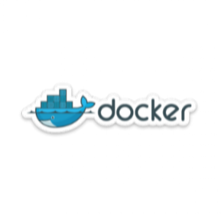


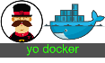
public registry
VM Scale Sets
Azure Container Service
Azure Hosted Docker Private Registry
ASP.NET
Test
Visual Studio Team Services
Azure Hosted Private Registry
Source Code Control
Build
Continuous Integration
3rd Party Integration:
Azure Container Service
Staging
VSTS Build Agents w/ Docker
Orchestration & Scheduling
Visual Studio
Integration
ASP.NET
In Container Development
Edit & Refresh
Breakpoint Debugging
Production
Debug
Write/Edit
Run
Visual Studio Code
Docker Language Services
Docker Scaffolding w/yo docker

Slide 49
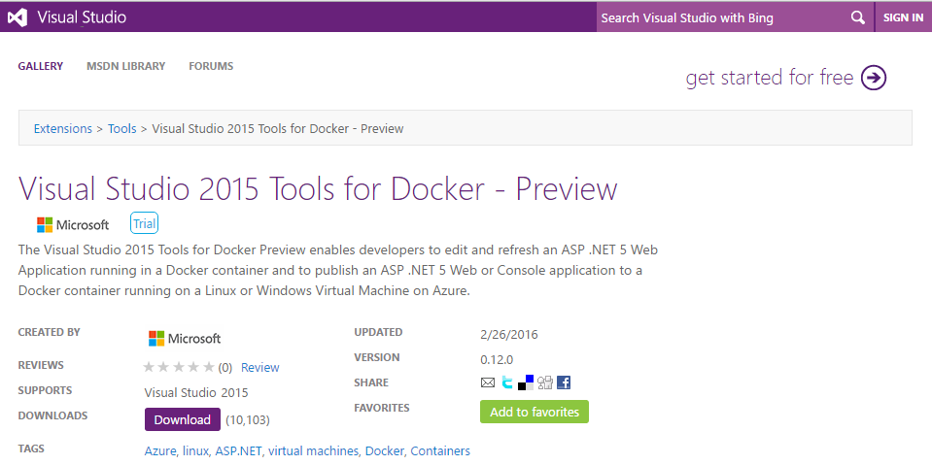
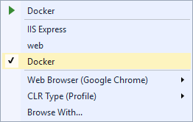
Docker Tools for Visual Studio
Scaffolds docker assets
Dockerfile, docker-compose.yml, DockerTask.ps1
Run and Test your code in a docker container
Linux today, Windows Nano coming soon
Edit & Refresh of code
Enable F5 – Start Debugging

Slide 50
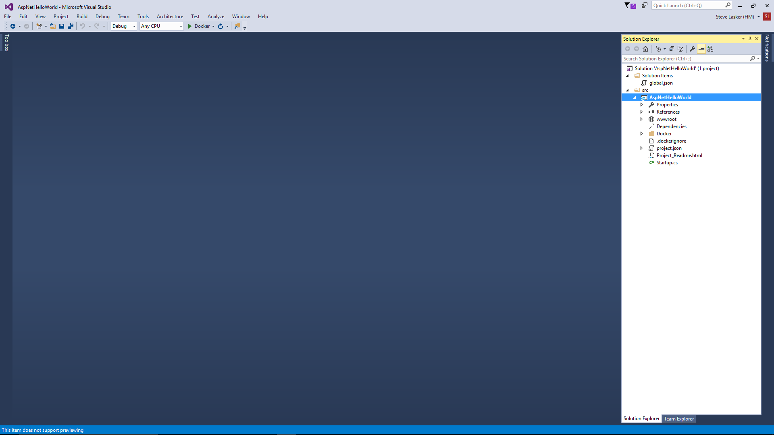
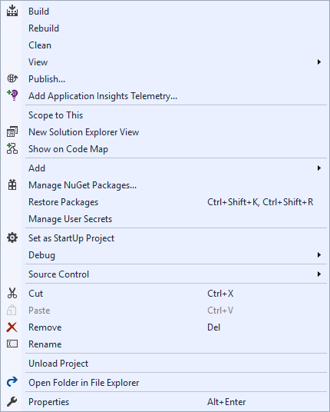
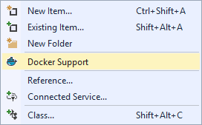
Docker Tools for Visual Studio

Slide 51
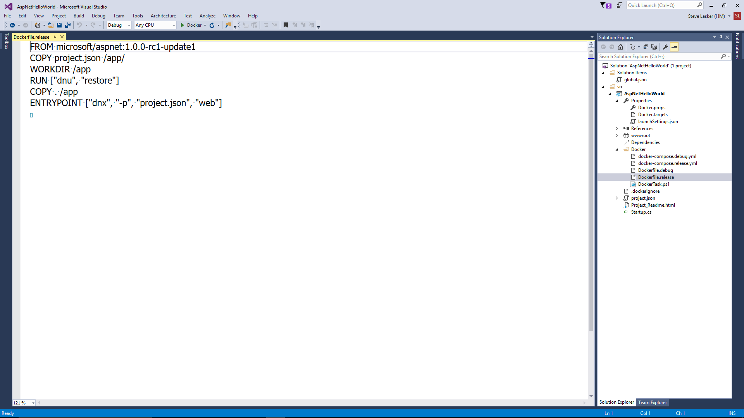
.dockerignore
Used by docker build and docker-compose build. Tells the docker runtime to ignore certain files from being copied to the container..
Docker.targets & Docker.props
Used by Visual Studio to hook the F5 experience
launchSettings.json
Docker entry point added to enable running in a Docker Container.
Dockerfile.debug
Builds an image, ready for debugging
Dockerfile.release
Release version, some optimizations removed. Release behavior for validations.
Docker-compose.debug.yml
Additional containers, with debugging support
Docker-compose.release.yml
Additional containers, with release behavior
DockerTask.ps1
PowerShell, to coordinate all the local operations. Similar to a makefile

Slide 52
Visual Studio Team Services
Docker “Steps” to aide in your build, validate, push scenarios
Integrated with:
GitHub for SCC
Jenkins for CI/CD

Slide 53
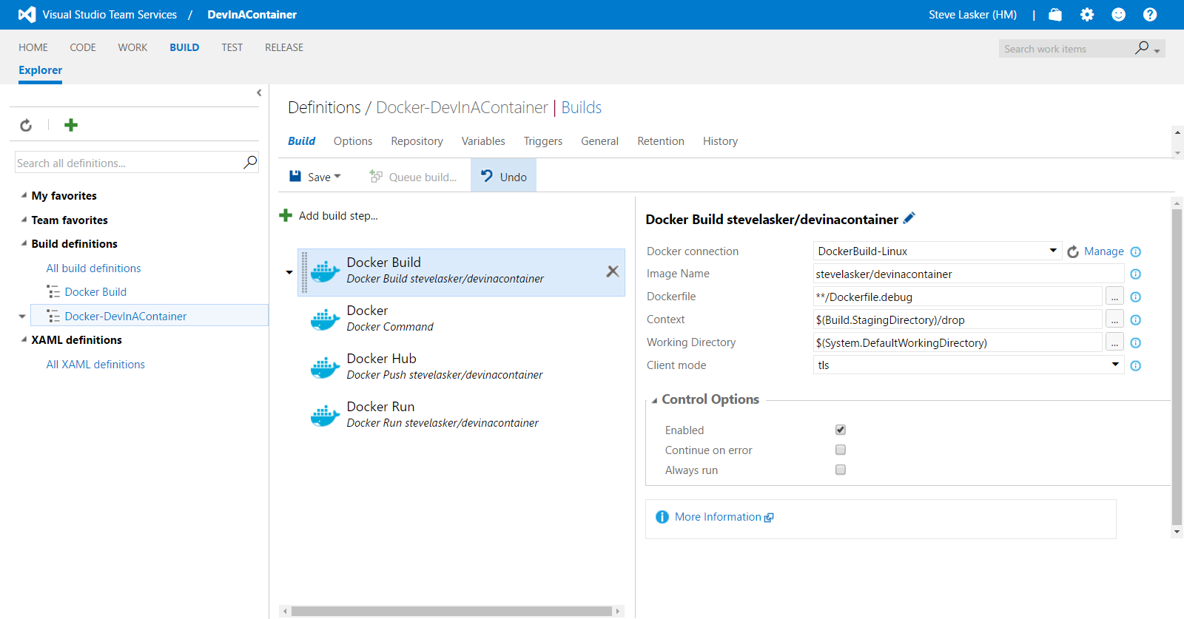
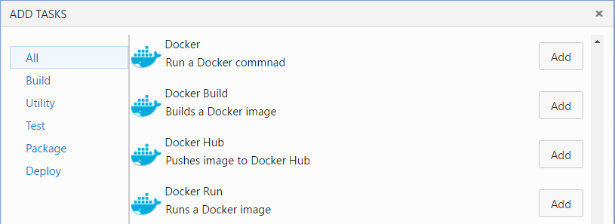

Slide 54
Azure Container Service A platform for reliable, hyperscale, container-based applications
Microservices
Flexible programming models
Open Source Orchestration
Azure Container Service
Host cluster management
Container hosts as cattle
Hyper-Scale
High Availability
High Availability
High Density
Open Source Container Management
Placement Constraints
Fast startup & shutdown
Self-healing
Azure
Private cloud
Other clouds
Notes:
Azure Container Service focusses on the configuration and management of the hosting infrastructure. We also provide key open source orchestration technologies. ACS does not provide an application development model. This has some advantages (e.g. more flexibility in application architecture) but some disadvantages (e.g. stateful applications need to be designed to manage their own state)

Slide 55
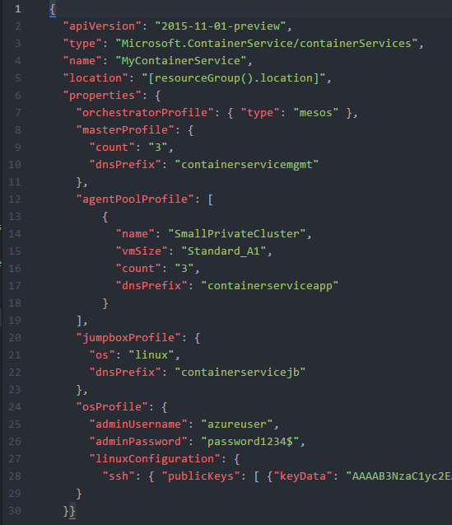
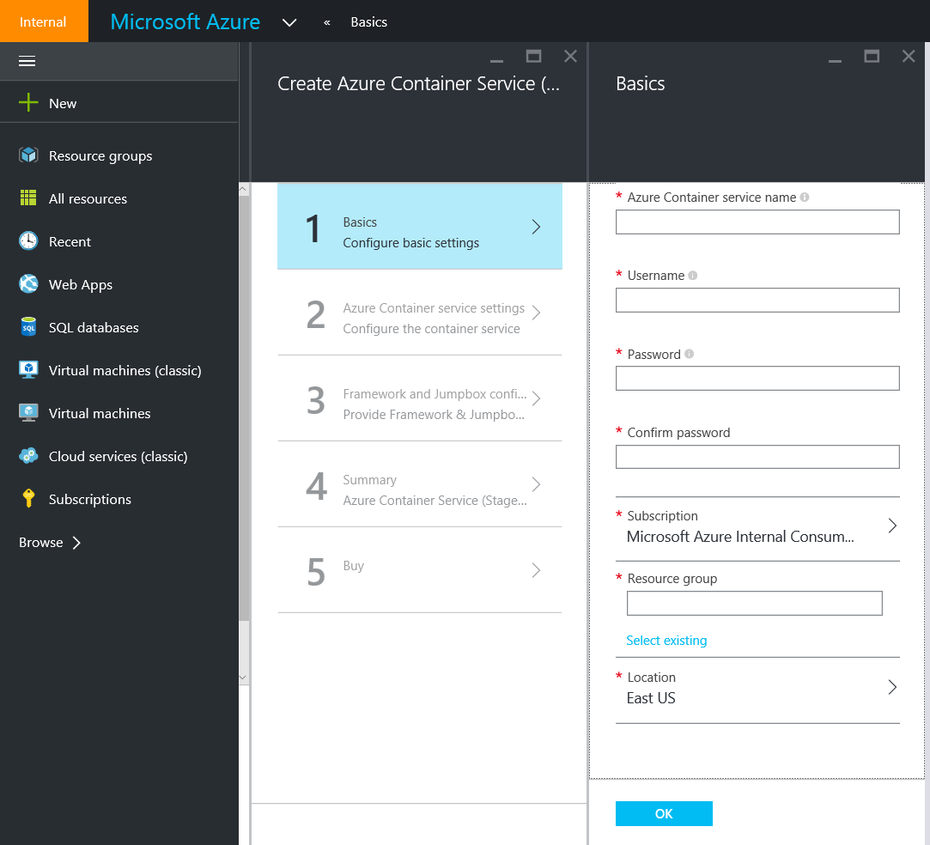
Deploy using Portal or ARM

Slide 56
Containers: a first class ARM resource
New Resource Provider
Defines required resources
Layered approach
Agility to track innovation
Community defined
Open Source and Open APIs
Portability
Hosts become cattle
No need to manage them
Containers are pets or cattle
Depending on application
Layer | Supported Technologies (2015)
Configuration as Code | ARM, Dockerfile, Docker Compose
Host cluster management | VM Scale Sets
Container orchestration | Docker Swarm, Chronos, Marathon, Apache Mesos
Monitoring | OMS, App Insights

Slide 57
Vocabulary
Agent
Client
Compose
Container
Dockerfile
Host
Image
Master
Orchestrator
Registry
Scaffold
Scheduler
Slave
Tag
Volume
Layers
Labels
Registry
Swarm
Container Services
Tags
Service
Ports
Commands
Docker-Machine Create, Env, Ip, Start, Restart, Active
Docker build, login, pull, push, run, search, tag
Docker-Compose Up, Build, Scale

Slide 58
Coming Into Port
Learned a new vocabulary
Explored the Container Workflow
Container Architecture & Deployment Differences
Explored some products to assist:
Docker Toolbox
Visual Studio
Visual Studio Team System
Azure Container Service
Had a little fun along the way

Slide 59

References:
aka.ms/DockerToolsForVS
aka.ms/DockerToolsForVSCode
aka.ms/yodocker
aka.ms/AzureContainerService
aka.ms/WindowsContainers
github.com/SteveLasker/Presentations/VSLive2016
https://github.com/CrosbyMichael/DockerUI
Steve Lasker
@SteveLasker
blogs.msdn.com/SteveLasker
Steve.Lasker@Microsoft.com

Slide 60
Appendix

Slide 61
Configuration Files
App Configuration Behavioral Values
Owned By: Development
How errors are handled
Depth of logging
JavaScript optimizations
Docker Configuration Location Values
Owned By: Operations
Database Connection String
Storage Connection Strings
Telemetry Keys
Instance Count

Slide 62
Image Cache
Images are cached in each docker host
Demo image cache
docker images
REPOSITORY TAG IMAGE ID CREATED SIZE
gcr.io/containerproject-1234/hello-node v1 b8271af8f8d1 3 days ago 637.1 MB
947960048989.dkr.ecr.us-east-1.amazonaws.com/helloworldaspnet latest 8297c2b3f476 4 days ago 1.421 GB
devinacontainer_devinacontainer 2016-02-24_17-41-41 8297c2b3f476 4 days ago 1.421 GB

Slide 63
Docker Registry
Repo for Docker Images
Public Registries – (Linux, Windows, Mongo, Jenkins, …)
Private Registries –(Your Corporate/Private Apps, )
docker pull mongo
Using default tag: latest
latest: Pulling from library/mongo
604d05dfd165: Extracting [====================================================> ] 34.78 MB/37.19 MB
a3ed95caeb02: Download complete
af271166b5e5: Download complete
ffff72610562: Pull complete
f1eec3212a77: Pull complete
e725d5f46b0c: Pull complete
82633c2ea8fc: Pull complete
1ec63dc1715b: Downloading [=========================> ] 29.72 MB/64.67 MB
9be54d5ae146: Pull complete
c3abf6246d6a: Pull complete
Digest: sha256:cbbc0a7be0926d017ffd952799c4864c2c6cf812cbb70862bf2c8539401aa1e3
Status: Downloaded newer image for mongo:latest

Slide 64
